Slide 1


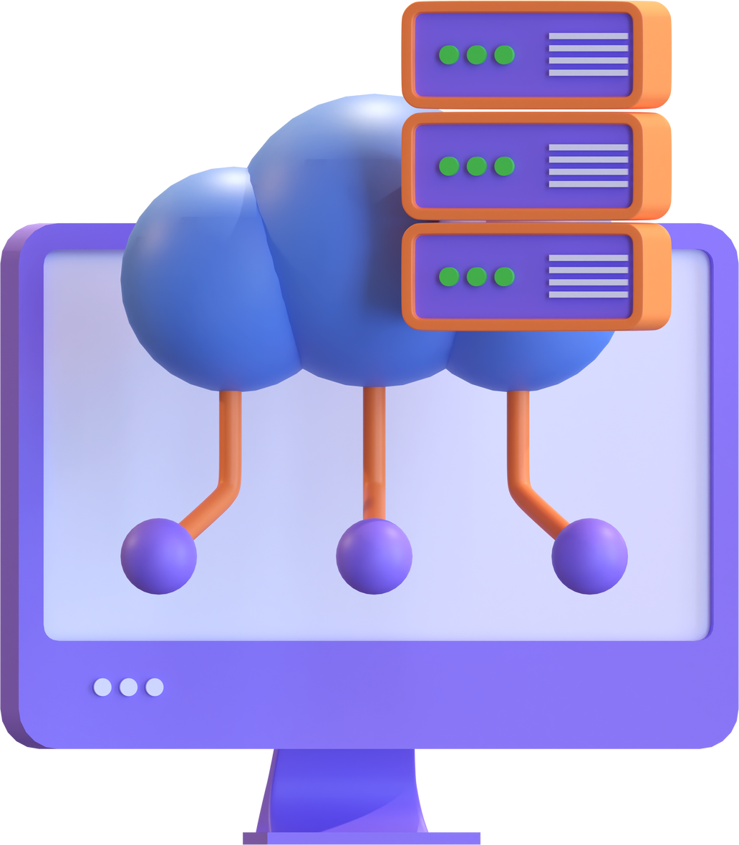


AUTHENTICO
AN ATTRIBUTE
BASED
SECURITY
MODEL
ON CLOUD

Slide 2

1 | PROBLEM AND SOLUTION STATEMENTS
2 | OBJECTIVE
3 | PROJECT ASPECT
4 | DJANGO WEB APPLICATION DEVELO﻿PMENT
5 | DATABASE CREATION A﻿ND EMPLOYEE REGISTRATION
6 | ATTRIBUTE-BASED AC﻿CESS CONTROL MODLE
7 | AWS CLOUD INFRASTRUCTUR﻿E SETUP
8 | FUTURE SCOPE
Agenda

Slide 3
PROBLEM STATEMENT
Role-Based Access Control (RBAC) systems encounter limitations in providing adaptable and finely-tailored access controls. These systems often struggle with dynamic permissions management and fail to offer the granularity required for modern applications
SOLUTION STATEMENT
Transitioning from RBAC to Attribute-Based Access Control (ABAC) poses significant challenges due to the need to define comprehensive attribute sets, map user attributes to access policies, and ensure seamless integration with existing infrastructure.

Slide 4






OBJECTIVES
Django Project & App Creation
Employee Registration & Authentication
Database Integration
ABAC &
Admin Functionality
AWS Policy, app Integration & Hosting

Slide 5
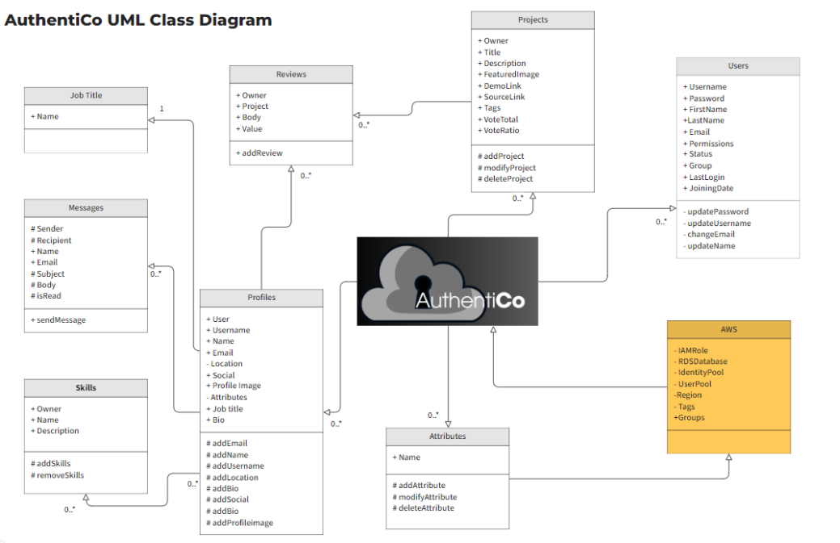

Slide 6


PROJECT ASPECTS
DJANGO WEB APPLICATION DEVELOPMENT
DATABASE CREATION AND EMPLOYEE REGISTRATION
ATTRIBUTE-BASED MODEL
AWS CLOUD INFRASTRUCTURE SETUP
Create two apps: 'users' and 'projects'.
Implement essential functionalities for user authentication, registration, login, and profile.
Design database models for user profiles, attributes, and projects.
Include user-specific data such as joining date, projects, groups, expertise, shifts departments, joining date, location
Create an admin page to manage users and projects
Define entities in attributes for user and tenants from database to maintain policies accordingly
Deploy application on AWS using Amplify.
Utilize AWS IAM for access, and RDS for database storage, Lambda for testing and Cognitio for access control management

Slide 7
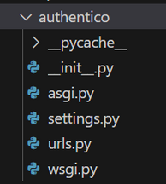
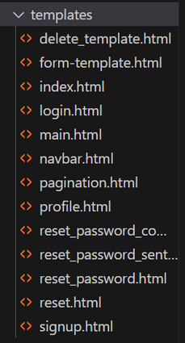
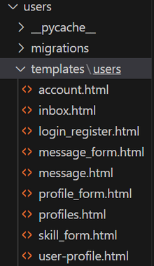
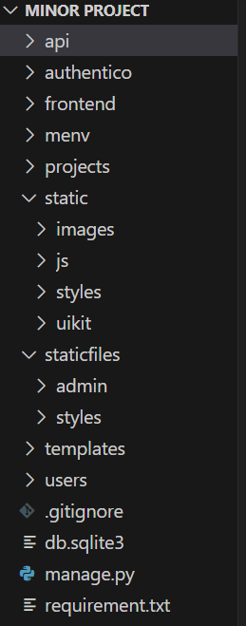
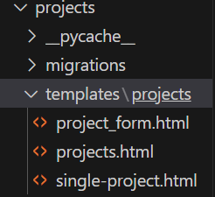
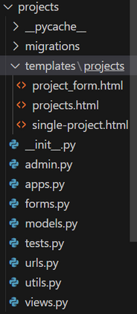
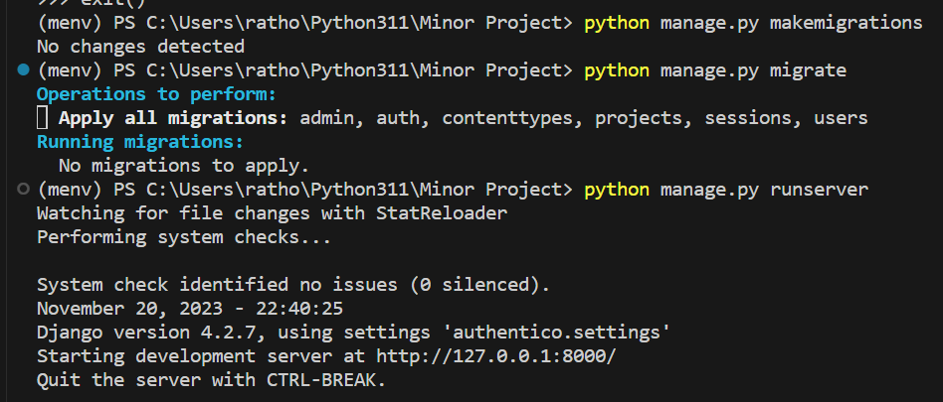
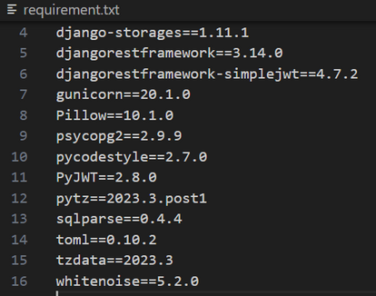
1st Aspect
Django Web Application Development :-
DJANGO PROJECT NAME
DJANGO APP NAMES
Template Creation
REQUIRED INSTALLATIONS
Django Server

Slide 8
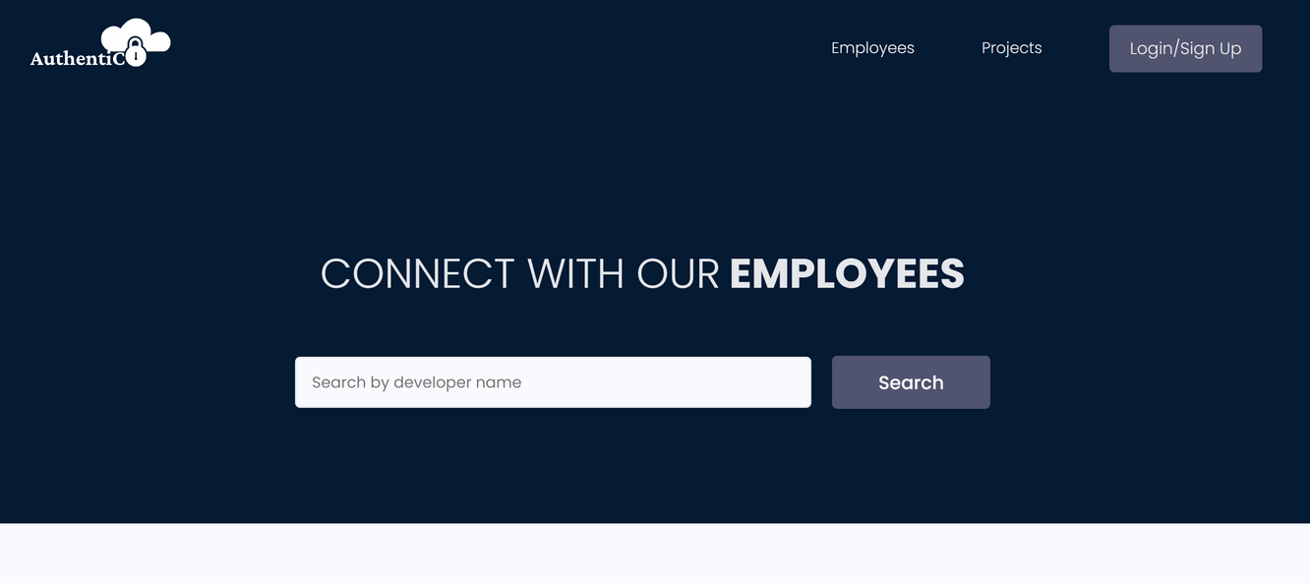
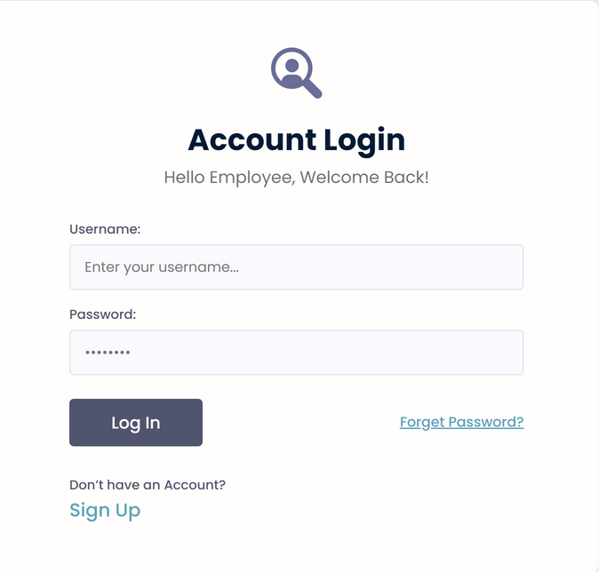
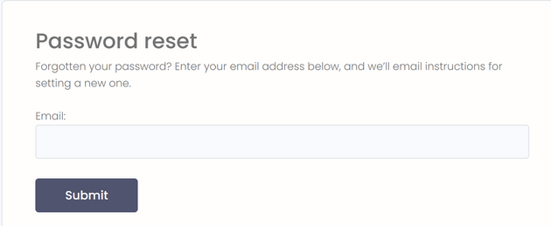
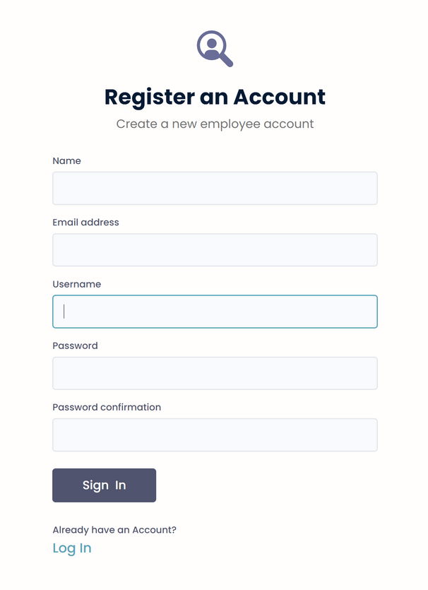
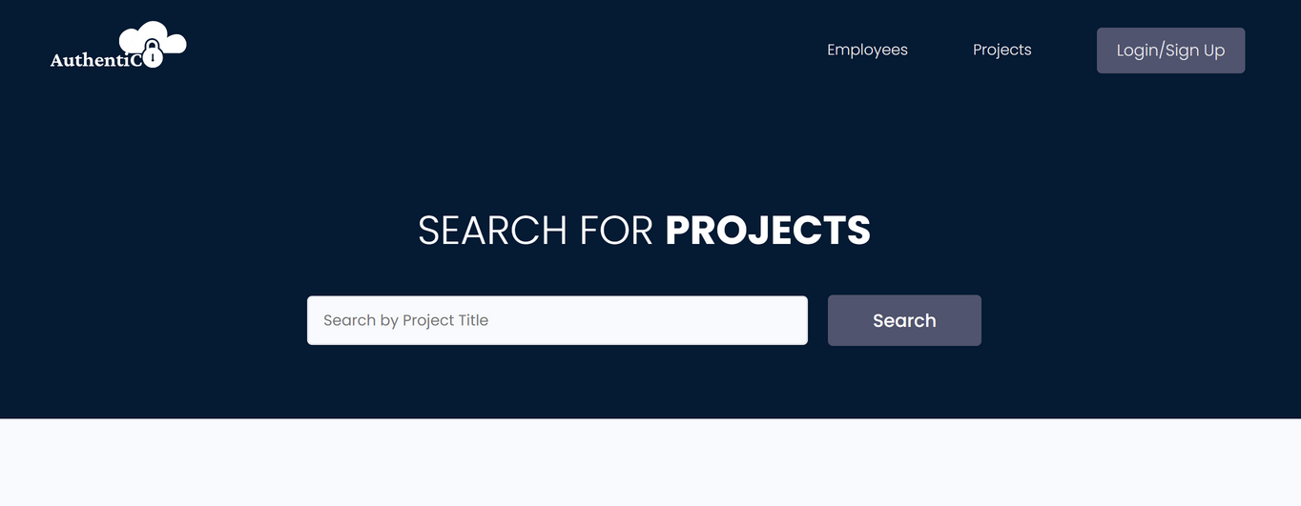
Login page
Password Rest page
SEARCH FOR EMPLOYEE
Home/Employee page
SEARCH FOR PROJECTS
Projects page
Sign Up page

Slide 9
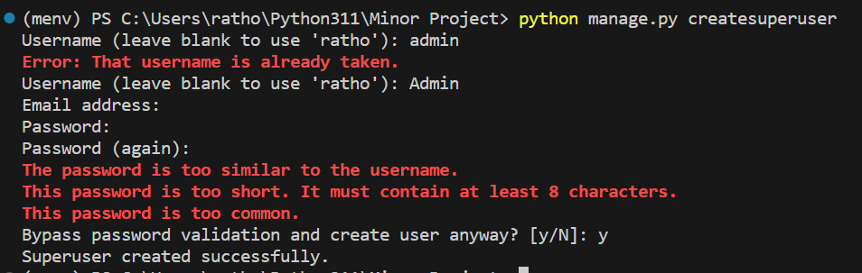
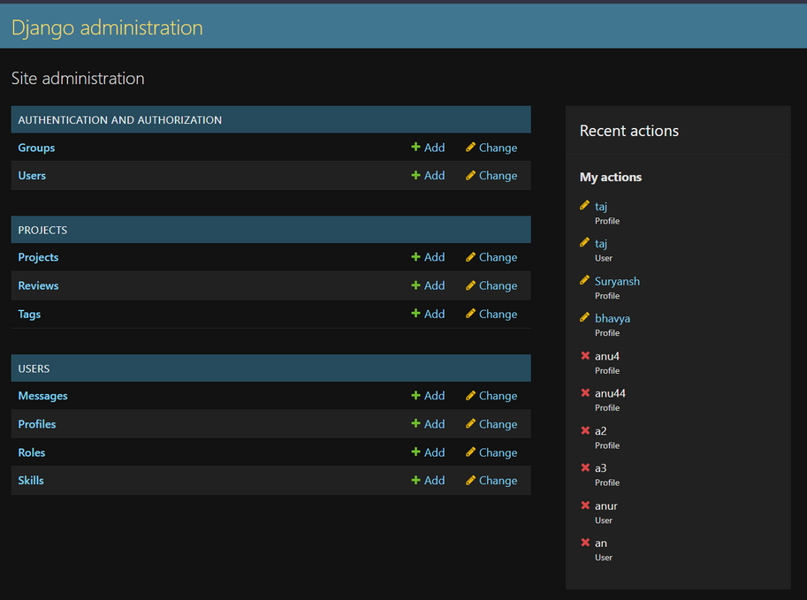
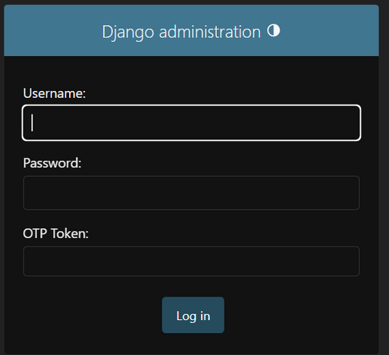
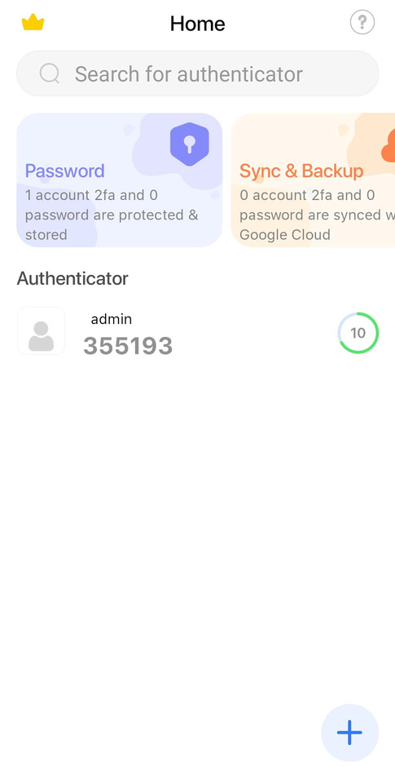
ADMIN PAGE:
Creating Admin
Otp on Google Authenticatio App
Logging in as Admin
Development of the Django Admin portal

Slide 10
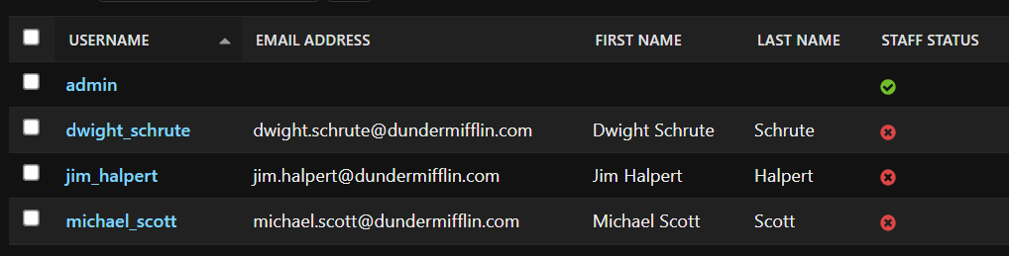
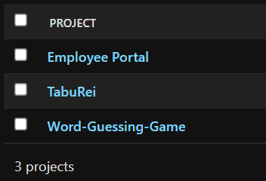
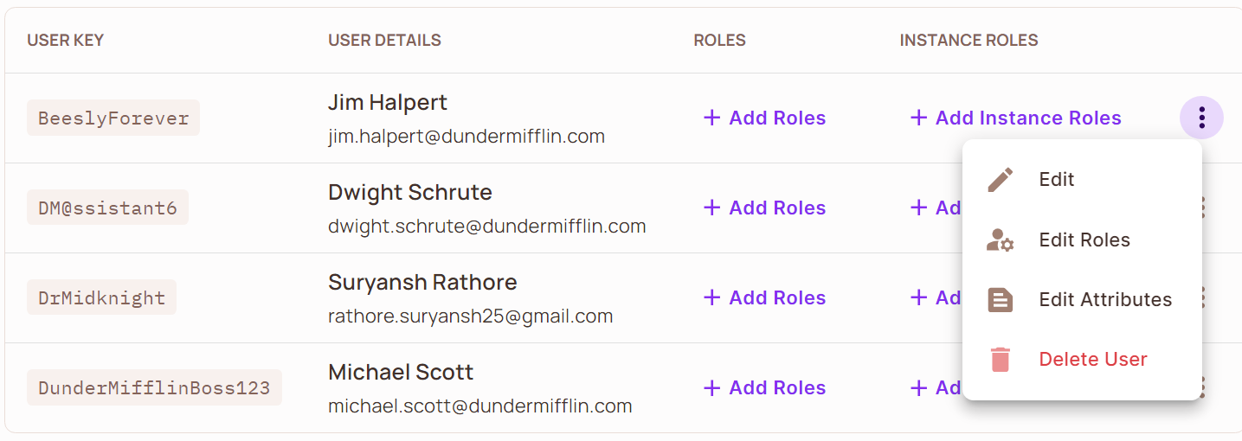
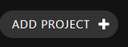
Database Creation and Employee Registration :-
2nd Aspect
Employee’s Projects
Employee’s Usernames
AWS RDS

Slide 11
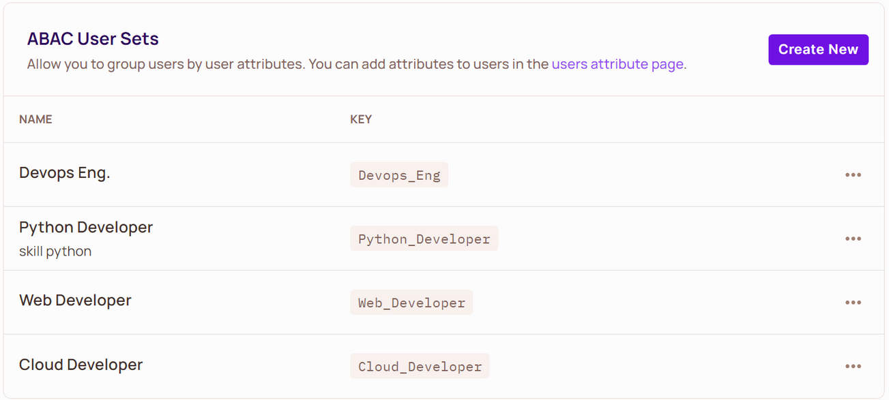
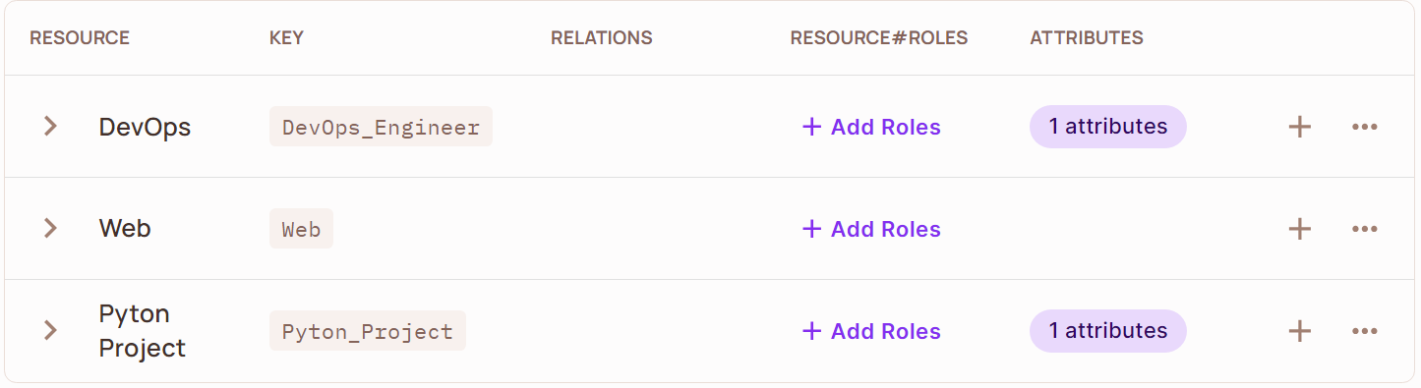
3rd Aspect
Attribute-Based Access Control :-

Slide 12
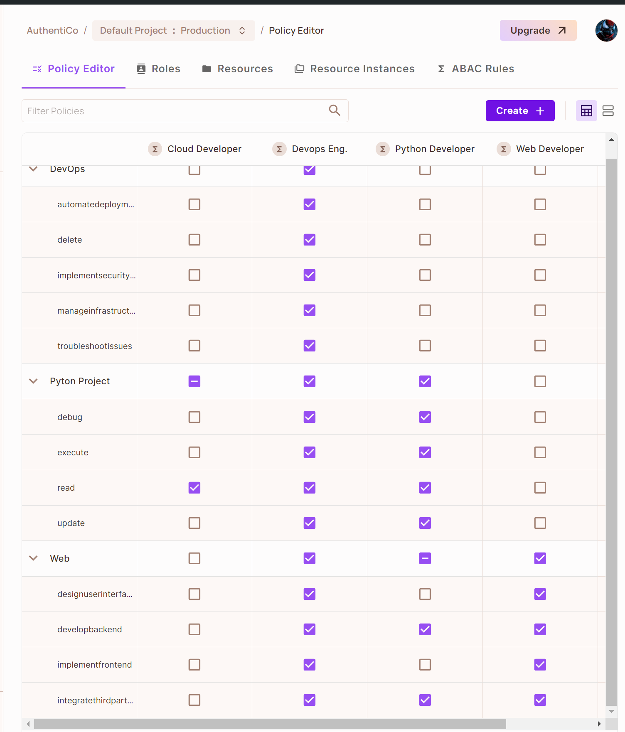
AWS POLICY:-

Slide 13
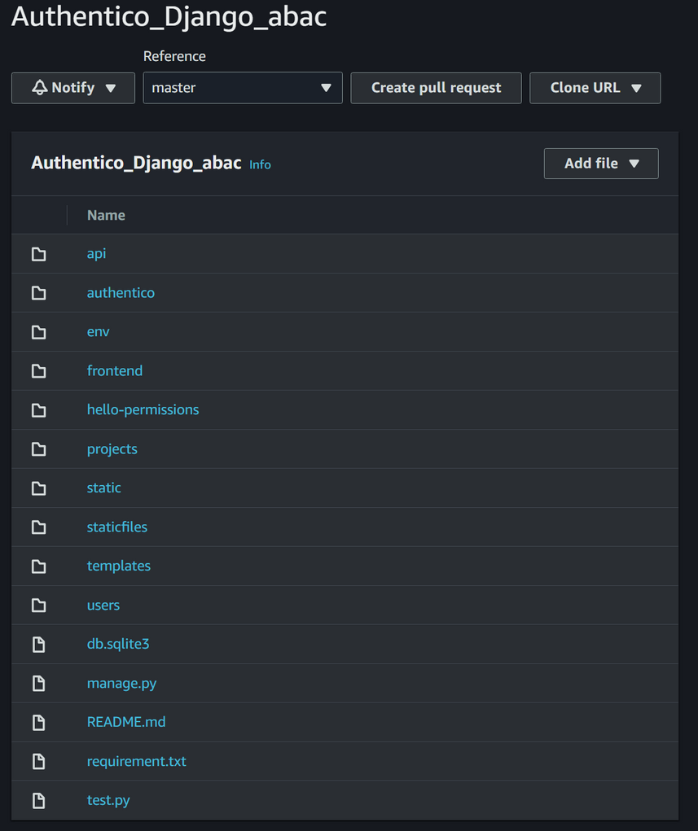
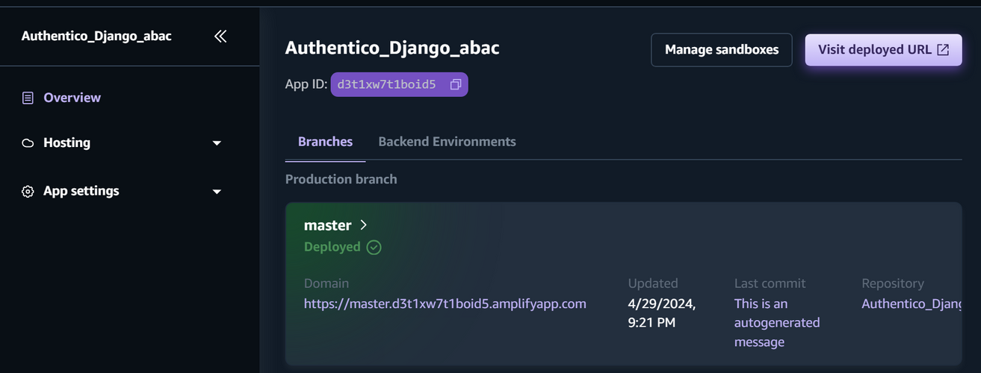
4th Aspect
AWS Cloud Infrastructure Setup :-
AWS CODECOMMIT
AWS AMPLIFY

Slide 14
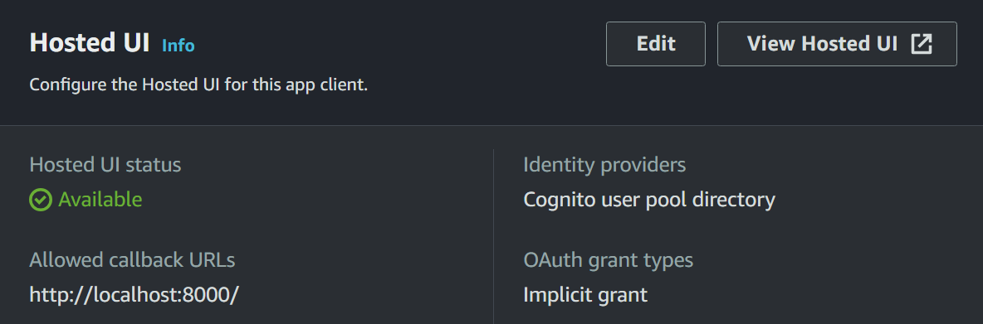
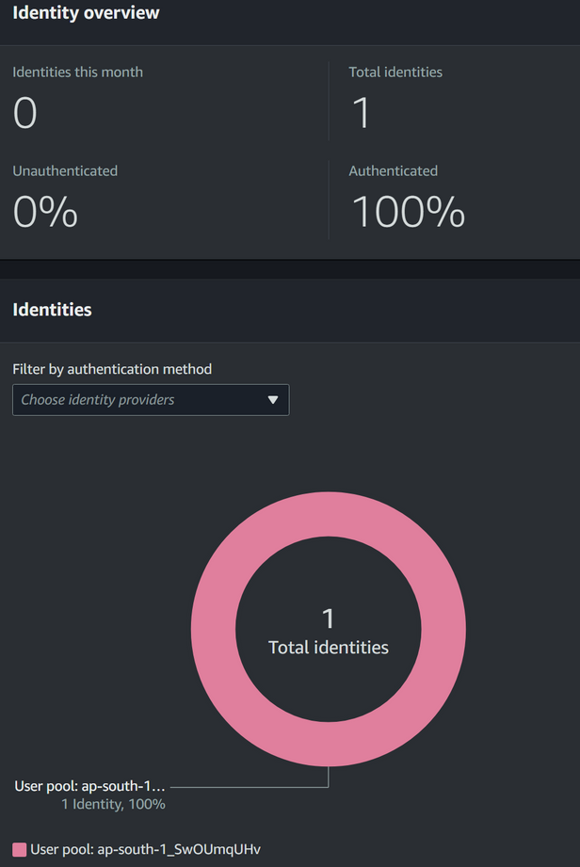
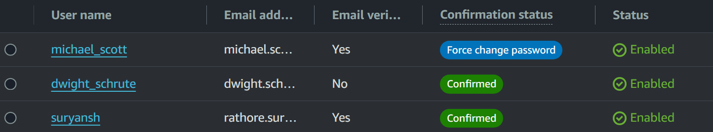
AWS COGNITO:-

Slide 15
FUTURE SCOPE :-
Integrating ReBAC (Relationship-Based Access Control) with attributes can enhance access control
Leveraging premium features of AWS such as AWS Shield for DDoS protection, AWS WAF (Web Application Firewall) for enhanced security, and AWS GuardDuty for threat detection
Adopting Docker for containerization offers benefits like portability, scalability, and resource efficiency.
Implementing CI/CD (Continuous Integration/Continuous Deployment) pipelines automates the software delivery process, streamlining deployment, and ensuring faster release cycles with minimal downtime.
Utilizing Terraform for infrastructure as code simplifies the management and provisioning of AWS resources. Infrastructure changes can be version-controlled, tracked, and automated, enhancing scalability, reproducibility, and reliability of the application's infrastructure.

Slide 16



THANK YOU

